Slide 1
Alpha Gamma State
Past State Presidents

Slide 2
Founded March 24, 1937
Founder Dr. Ethel Parker, Beta 1937-39
Lillian Logan, Alpha 1939-42
Ruth Riley, Zeta 1942-44
Noma Dix Winston, Iota 1944-46
Louise Worthington, Beta 1946-48
Ona Bell Demaree, Alpha 1948-50
Founder Sara Rives, Zeta 1950-53
Katie Murrell, Iota 1953-55
Edna M. Lang 1955-57
Margaret Clayton, Theta 1957-59
Lillian Lowry, Gamma 1959-61
Virginia Murrell, Zeta 1961-63
Jean Doyle, Beta 1963-65
Meta Riley Emberger, Alpha 1965-67
Bess M. Hays, Nu 1967-69
Vista Morris, Rho 1969-71
Nancy McClure, Beta 1971-73
Anna Chambers, Eta 1973-75
Faye S. Hopper, Omicron 1975-77
All deceased

Slide 3
Dr. Dorine Geeslin, Mu 1977-1979
Dr. Dorine Geeslin, Mu 1977-79

Slide 4
Rozellen Griggs, Zeta 1979-81
Emma McPherson, Lambda 1981-83
Virginia Mutchler, Delta 1983-85
Ann Walls, Alpha 1985-87

Slide 5
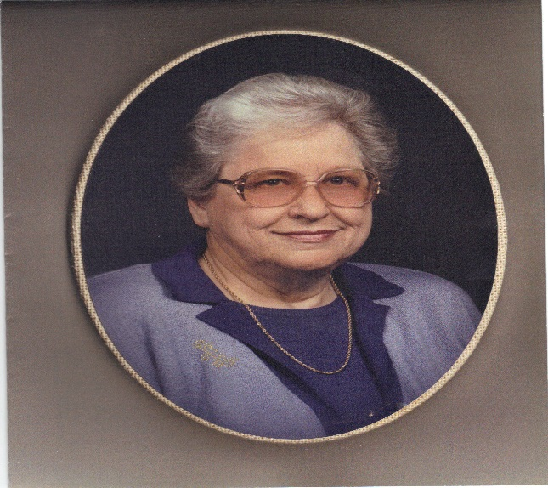
Delphia Hicks, Tau 1987-89
“Problems, Promise, Prospects” That was the theme during Delphia’s biennium as President of Alpha Gamma State. During this time there were 31 chapters with approximately 1900 sisters in the state.
Delphia was born near Prestonsburg, Kentucky. She started school in a one room school house and walked a mile to and from school through 7th grade. Delphia graduated from Prestonsburg High school and received a BS in from Pikeville College, two Master’s Degrees from Eastern State University and other certifications from Morehead State University. She began her teaching career in the one room school she had attended at 18 years old with an emergency certificate. She taught for 12 years while she earned her degrees and after consolidation she became a Junior High reading specialist and kindergarten teacher for 24 years. Later in her career she taught for two years at Morehead State University. Delphia is married to Donald and has a son Derek, a daughter Lynn and four grown grandchildren and a great granddaughter.
Delphia was initiated into Tau Chapter of DKG. She served as President of Tau chapter and became involved in Alpha Gamma State. This involvement included the positions of state corresponding secretary, recording secretary, second vice, first vice and ultimately President of Alpha Gamma State. Internationally she served on the Membership committee and served for 2 years as its chair. She also served on the 1992 International Convention Steering Committee. Due to this upcoming event her biennium was a time of coming together and bonding. The emphasis included getting members from chapters throughout the state involved in Alpha Gamma State activities and those of DKG International. Two new chapters were installed during her time as President.
Although Delphia her schooling in a one room school house, she expanded to teaching and learning throughout the state and nation with her work in DKG

Slide 6
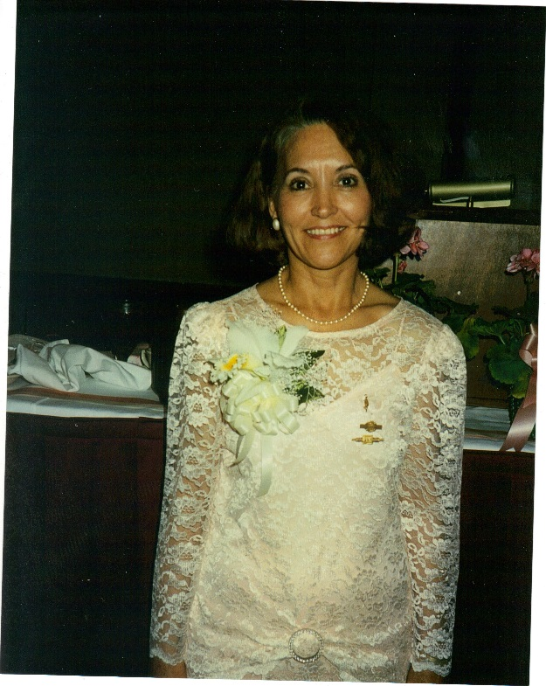
Dr. Carolyn Wells, Alpha Alpha 1989-1991
Dr. Carolyn S. Wells served as President of Alpha Gamma State from 1989-1991. During her biennium she challenged all of the chapters in the state with her theme: “Expand, Expect and Excel.”
Carolyn was born in a converted school house near Lancaster, KY. She was raised on a farm near Lancaster and remembers her first teaching “job” was that of teaching her mother how to read as she went through elementary school. Carolyn loved education and finished her own education with a high school diploma, a bachelor’s degree from the University of South Florida, two master’s degrees- one from the University of South Florida and one from Eastern Kentucky University and a doctorate in education in 1997 from the University of Kentucky. Carolyn began her teaching career in Pasco County, Florida and taught there for twelve years. While she lived in Florida she was inducted into the Delta Kappa Gamma Society International. She was the Carter President for the Gamma Mu Chapter in Florida. After teaching in Florida for 12 years Carolyn moved back to Kentucky. She went to work at Lancaster Grade School as a Learning Disabilities Teacher and soon became the director of Special Education for the Garrard Schools.
After moving back to Kentucky Carolyn transferred her membership in DKG to the Alpha Alpha Chapter. She started serving that chapter as program chairperson and eventually became President. Carolyn started her involvement with Alpha Gamma State as the Chair for the Personal Growth and Services Committee. From here she moved up the ranks from second vice president to president. Much of her biennium was spent in the planning stages for the international convention that was held in Louisville in 1992. Carolyn was instrumental in this process. Also during this time Carolyn saw her theme at work. Two chapters were installed!!
Carolyn was also proud of the fact that during her time as President of Alpha Gamma State she visited every chapter in Kentucky. Carolyn had some great experiences while visiting with each of the chapters and even recalled a poem she heard at one chapter meeting which was written by Dr. Rostada entitled “The Brain”.
Our ends are joined by a common link
With one you sit and one you think,
Success depends on which you use—
Heads you win—Tails you lose!!

Slide 7
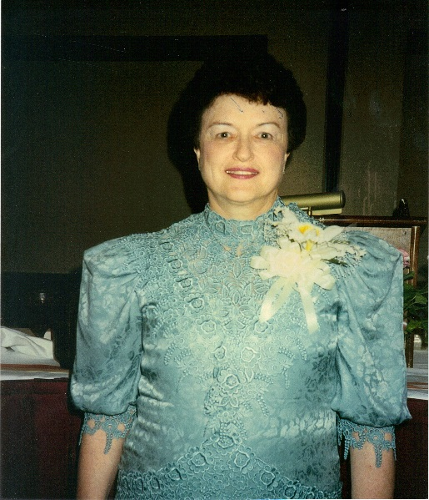
Jean Baugh, Xi 1991-1993
Jean Baugh was President for Alpha Gamma State from 1991-1993. This was a busy time of our organization as the 1992 International Convention was held at the Galt House in Louisville. This convention had more than 2000 Delta Kappa Gamma sisters in attendance and was an event that many still remember.
Jean was born in Canton, MS and grew up in several towns in Mississippi. She attended Mississipi College where she received her Bachelor of Arts degree. While attending Mississippi College she met Ivan Baugh and was married the year after graduation. Jean and Ivan lived in Jacksonville, Florida and it was here that her daughter Grace Lenelle was born. Later Jean and Ivan welcomed their son David into the family. They moved to Louisville for Ivan to Attend Southern Baptist Seminary School of Music and Jean began substitute teaching. She transitioned to a full time teacher at Greenwood Elementary. Jean and Ivan moved to Texas and Jean completed her Master of Education degree at Howard Payne University. She taught 7 years in Texas before moving back to Jefferson County. She taught for Jefferson County Public Schools and became a member of XI chapter in 1979. She taught in Jefferson County Public Schools, retiring from St. Matthews Elementary. She pioneered the use of technology in the elementary classroom, serving on her schools' cadre of teachers who provided site-based leadership.
She was active in The Delta Kappa Gamma Society International, serving Xi chapter as second and first vice president as well as president, the Alpha Gamma State as state second and first vice president, as well as president and later as state treasurer. She participated in the 1988 Leadership Management Seminar sponsored by The Delta Kappa Gamma Society International, and served on the International Educator's Book Award and the International Insurance committees. During Jeans biennium the by-laws and standing rules of Alpha Gamma State were revised. Also during the International Convention a paper was presented regarding educational reform/KERA.
This tireless worker went to her heavenly home on November 8, 2010. She will always be remembered for her love for Delta Kappa Gamma and her commitment to its purposes.

Slide 8
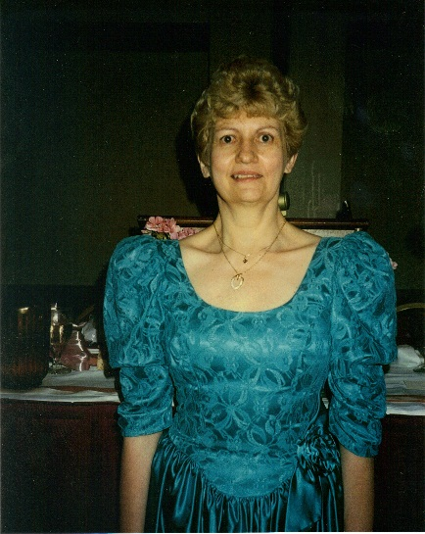
Sue Story, Mu 1993-1995
“An Agenda for Action- Color Me Active” This was the theme of Sue’s Presidency. And boy did she follow that theme!! During her biennium she encouraged chapters to: keep in touch with members who were facing personal or family concerns, plan meetings that would be worth the time invested, commit to action projects, commit to growing personally and professionally, have a chapter that explodes with vim, vigor and vitality, encourage members to wear their key pin on the first Monday of each month and to every professional meeting, place copies of the Bulletin in public places. During Sue’s biennium she was pleased to welcome a newly established chapter, Alpha Mu.
Sue has been very active in Mu chapter, serving as second vice, first vice, President and member and/or chair of numerous chapter committees. This carried over to the state level where she served as corresponding secretary, chair of the state expansion committee, chair of the program committee, chair of the strategic plan for renewal, chair of the leadership development committee, char of the order of Tulip Poplars, first vice ,President, and then Parliamentarian of Alpha Gamma State. She is proud to have been inducted as a charter member of Alpha Gamma State Hall of Fame. At the International level Sue has been a member of the golden gift class, chair of the scholarship committee, chair of the elections committee, chair of the travel and study committee and a member of the scholarship, research and expansion committees. She has been a workshop presenter at International Conventions in Toronto, Dallas and San Diego.
Sue was born in Hardin County and graduated from Howevalley High School. She received her BS from Campbellsville College and her MA and Rank I from Western Kentucky University. She taught English/Journalism at North Hardin Junior High, North Hardin High and Central Hardin High. I guess she couldn’t keep a job!! She has also taught English at ECTC.
Sue is involved in both district and Local retired teachers’ associations and her church. She says she collects cookbooks – she doesn’t cook from them – just read them!

Slide 9
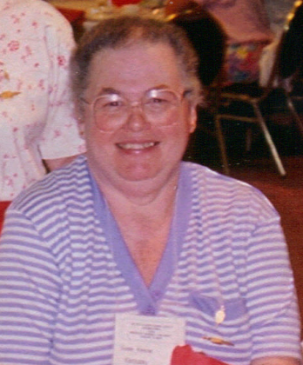
Susie Keene, Nu 1995
Susie Keene was elected President of Alpha Gamma State on April 22, 1995. This was after she had served on the state level as corresponding secretary, recording secretary, second vice and first vice. She was to serve during the 1995-1997 biennium. Tragically Susie fell from her second level porch on May 11, 1995 and sustained multiple injuries. She was unable to overcome this fall and passed away on June 6, 1995 at Pikeville Methodist Hospital.
Susie taught in the Pike County Schools and served as a librarian. In 1988 she was named Outstanding School Media Librarian. At her funeral Rev. Blackburn described Susie as the type of person who had “time for the big things in life,” but also had “time for the small, special, thoughtful things in life.” Susie was married to Bruce and had one daughter, Rebecca who is also a member of Nu chapter of DKG.
Susie was a member of Nu chapter of DKG and will always be remembered by her sisters as having a mile to offer everyone she met; willing to lend a helping hand and interested in what was happening in the world.

Slide 10
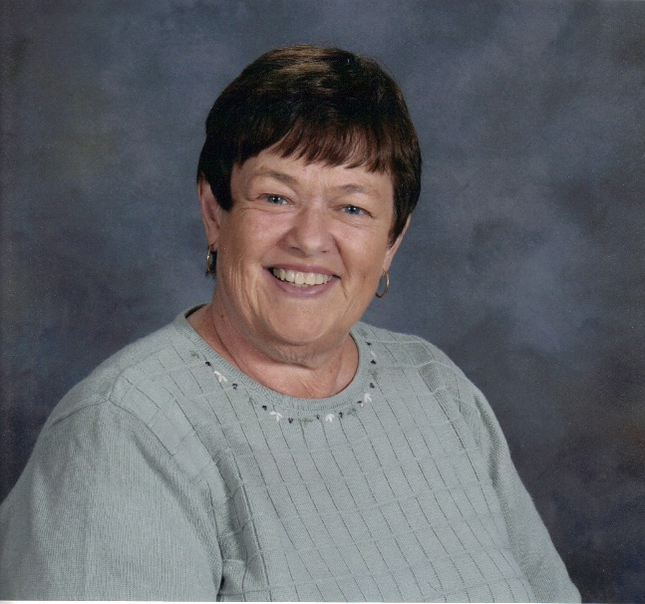
Lynn Werner, Omega 1995-97
Lynn Werner became President of Alpha Gamma State after the untimely death of Susie Keene who had just been initiated as President. Lynn “hit the ground running” and worked to continue the vision that Susie had started. Her theme was “membership” and she worked tirelessly to encourage chapters to gain new members and even start new chapters. DKG was losing members due to the rigors of KERA and the expansion committee set a goal of 40 chapters. In April of 1996 Alpha Nu Chapter was started which brought the state to 37 chapters and 1900 members. During Lynn’s biennium the first archive committee was appointed and discussion was held about where to store our records. During the 1997 state convention in Paducah beginning discussions were held about the collection of volunteer hours. The major emphasis during her time as President was renewing commitment to the Society.
Lynn was born in Paducah and has lived there her entire life (except one year spent in Richmond, VA). She graduated from David Lipscomb College in Nashville with her BS in elementary education and continued her education by receiving a Master’s degree from Murray State University. Lynn spent taught in the McCracken County School District – 34 years at Lone Oak Middle School, 6 years in the McCracken County Gifted/Talented Academy and 6 years as an adjunct instructor for Murray State University at the Crisp Center in Paducah.
Since retirement Lynn has served as the volunteer coordinator for the Red Cross Blood Donor Services in McCracken County. Twice she had been named the Volunteer of the Year for the Tennessee Valley Region Blood Donor Services. Lynn teaches children’s bible classes at her church and has done so for 42 years.
Grandchildren are the reason we keep our sanity while we are trying to raise our own children and Lynn has 3 who are most precious to her. These grandchildren have a wonderful mother who is Lynn’s daughter.
Skipping a biennium in preparation for the presidency did not affect the Lynn’s great service to Alpha Gamma State. She served with dedication, purpose and most of all love.

Slide 11
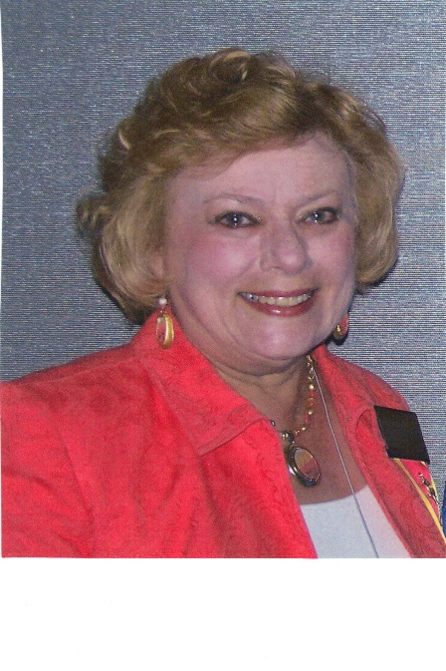
Donna Smith Goodin, Xi 1997-1999
Donna Smith Goodin is truly “from Louisville.” She was a late Christmas present to her parents being born on December 26th. Donna is the older of two girls. Her sister Tina Shawler is also an educator and member of DKG. Donna completed her primary and secondary school education in Louisville and then went to Murray State University where she received her BS in Elementary Education and Mathematics. She began her teaching career as a Mathematics teacher at Westport High School. She then moved to Fern Creek High school in the same position and while there received her MAT in mathematics from the University of Louisville. Donna continued her education while continuing to teach and received her certification in Supervision and Administration from Western Kentucky University. From the high school classroom Donna moved to become a regional mathematics resource teacher for three years and then a middle school mathematics resource teacher. Donna moved into the role of administrator serving as an Assistant Principal for 9 years and Interim Principal for one year in two middle schools in Jefferson County.
Donna became President of Alpha Gamma State in 1997 with the theme of “Let our Light Shine.” During her biennium chapters began reporting volunteer hours and the first report was 53,775 hours in 1998. International had a focus on technology at all levels and we began work on our website during her term as President. Also during this time chapters were given packets on strategic planning and encouraged to work on this within their own chapters. Lawsuit? Yes, during Donna’s biennium one was filed for discrimination since DKG did not admit men. In 1997 the northeast regional conference was held in Sweden – the first time one was held outside of the U.S.
Donna is married to Roger and has one son, David Smith and a grandson, Cameron.

Slide 12
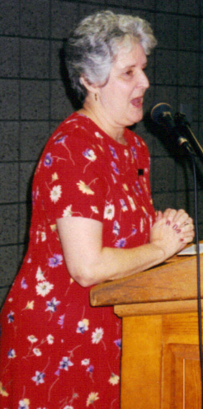
Carolyn Garriott, Zeta 1999-2001
“Empowering Our Members” This was the theme of Carolyn Garriott’s biennium. Carolyn was a firm believer in participation by the members of DKG across the state and during her Presidency two regional fall workshops were started – one in the east and one in the west, to encourage more participation. For the first time, PD credit was offered to those attending the workshops. Unfortunately at the 2001 state convention in Lexington, two chapters, Alpha Kappa and Alpha Eta requested that they be dissolved.
Carolyn was very involved in DKG at both the chapter and state level. She served as President of Zeta chapter from 1984-1986 and has chaired or served on several committees at the chapter level. At the state level she chaired the communications and history committee and held the offices of corresponding secretary, second vice, first vice and then President. Carolyn also was a co-presenter of a workshop at the Northeast Regional Conference in 1987 at the Greenbrier.
Carolyn received her BS in Elementary Education from Eastern Kentucky University and a Masters of Education and Maters of Literature and Languages from Morehead state university. She taught elementary education for the Bellevue Independent schools and even received a grant from the Kentucky Department of Education to put a computer in the classroom with the assistance of a resource person to work with her class on creative writing and dramatic presentation.
Carolyn is a talented musician and has served as organist for her church. She also directed and played in the bell choir for her church and belonged to the Northern Kentucky Community chorus.
Those who speak of Carolyn during her tenure as president remember her beautiful print dresses and a lady who led us to become an empowered society.

Slide 13
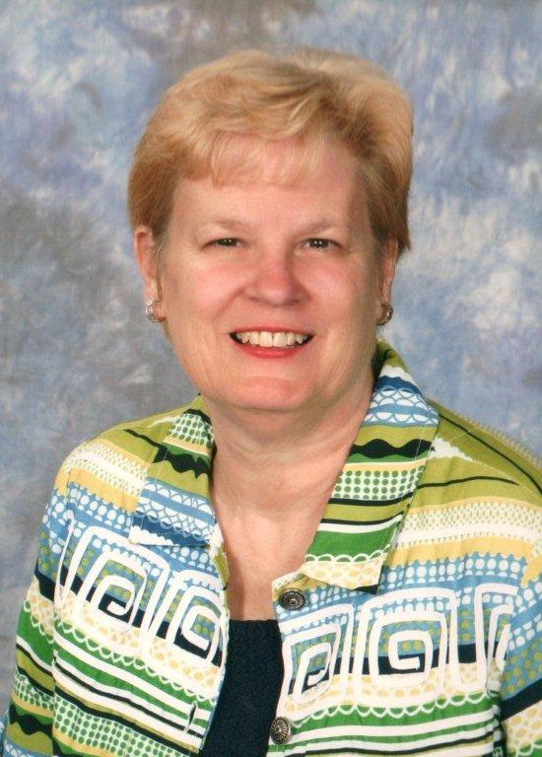
Susan Cross, Mu 2001-2003
Dedication is a word that can be used to describe Susan Cross. Born, raised, educated, taught and eventually retiring from Hardin County Schools, Susan believes in staying active in her community to make it a better place for the children of the future. After graduation from North Hardin High School, Susan received her BS from the University of Kentucky with a major in English and a minor in Library Science. She then received a MSLS from Spalding University and a Rank I in education from Western Kentucky University.
The theme during Susan’s biennium was “Color Me Active”. And that she is!! During her biennium Alpha Gamma State lost 2 chapters: Alpha Eta and Alpha Kappa. We agreed to move from 4 state newsletters and year to 3 and voted to move Alpha Gamma State from the northeast region to the southeast region. Also during Susan’s tenure we began the silent auction on baskets at the convention to help fund the Nancy McClure Leadership Fund. Susan also addressed the southeast regional assembly in Raleigh and spoke of our excitement in joining this group.
Susan taught English and was a Library Media Specialist at North Hardin High School – her alma mater. While there she was the speech and debate coach and academic coach. She served on the state board of directors for both of these organizations. Susan still attends her home church and is also very active there. She and her husband Hugh have two daughters and three beloved grandchildren. Since retirement she spends time both at home with one of them and in North Carolina where the other two live.
Susan continues to the active in Alpha Gamma State. She chaired the conference committee for the most recent Southeast Regional that was held in Louisville and continues as the editor of the state newsletter.

Slide 14
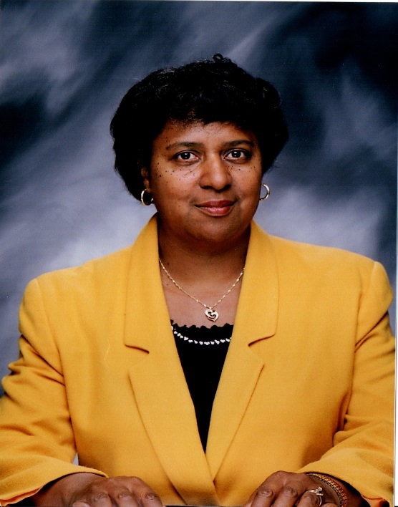
Janice James, Xi 2003-2005
Janice James believes in educating the students who are identified as gifted. She has been doing this in Jefferson County Schools for quite some time. She currently serves as a district-level resource teacher for gifted education. Teaching and encouraging are two of Janice’s strongest qualities and she carried this trait into her biennium as President of Alpha Gamma State.
Janice received her BA from Morehead State University and continued her education gaining both a Master’s degree and Rank I from the University of Louisville. She was inducted into the Xi chapter of Delta Kappa Gamma in 1984 and immediately became active in all aspects of the society. She served as membership co-chair, second vice, first vice and President, secretary and committee chair of professional affairs and personal growth and service for her chapter. Janice then became active at the state level service as a committee member for the SE regional conference in 2011, second vice, first vice and President of Alpha Gamma State. Janice’s service didn’t stop there. She has given the opening inspiration at two international conventions, was a floor page at a convention and a member of the first International Educational Excellence Committee.
During her biennium as the Alpha Gamma State President Janice had to oversee the transition of the state treasurer from Jean Baugh to Joyce Miller. She formed an ad hoc committee to study the qualifications for starting a State Hall of Fame and initiated state leadership breakfasts at state conventions.
All of this work was completed with the support of her husband Robert and her two daughters.
Janice truly modeled the theme of her Presidency – “Focus with Purpose and Action.”

Slide 15
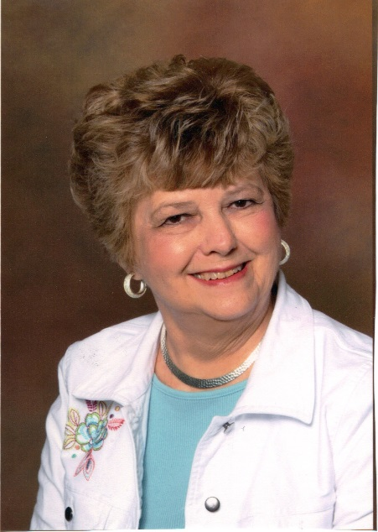
Charlotte Benton, Omega 2005-07
“FOR SUCH A TIME AS THIS”
That was the theme for Charlotte’s biennium as President of Alpha Gamma State. And that it was! During Charlotte’s time in office a hurricane named Katrina hit the gulf coast. Our state collected 300 backpacks of school supplies and materials 138 teacher bags and $2000 that was delivered by Ramona Jeffries to Alabama and Mississippi.
Also during the 2006 convention three chapters were dissolved at their request: Alpha Theta, Alpha Mu, and Alpha Nu. Alpha Gamma State celebrated its 70th birthday by remembering our founders. After this celebration the ad hoc archives committee was dissolved and their work was transferred to the History committee. Action was also taken to return to one fall leadership conference.
In 2005 members of Alpha Gamma State participated in their first southeast regional conference in Williamsburg, Virginia. We had added a line item to the budget for a hospitality event at this conference and Kentucky made its mark on the region with this event.
Charlotte was born in Milan, KY, raised in western KY and graduated from Heath High School. She received her B.S. in business education and Masters in education from Murray State University. Charlotte has taught for 45 years at Reidland High School and currently also teaches at McCracken County Alternative school. She is very active in teachers associations at the local, state and national levels. As if this isn’t enough, Charlotte is also very active at her church and has served as the organist for 35 years.
Charlotte is married to Kenneth and has two wonderful children, Michael and Michelle and a son-in-law Joey. She was a charter member of Omega chapter and has served in various positions including President for seven bienniums. At the state level Charlotte served as Second Vice, First Vice and then President. She travelled throughout the state visiting local chapters and meeting many wonderful key women educators. She was always seen at the conferences and workshops sporting a tailored red suit!

Slide 16
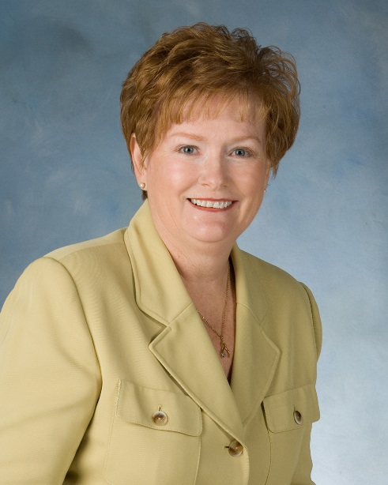
Ramona Jeffries, Mu 2007-2009
Ramona Jeffries says her hobbies include spending time with her grandchildren, working in her garden, making quits, cooking and entertaining family and friends and traveling with family and friends. But, how does she have time for hobbies?
Ramona is a member of Mu chapter and has served on many committees and as chapter President. Ramona has also not only served as President of Alpha Gamma State but as chair of the leadership development committee, a member of the history committee and a member of the personal growth and services committee. She worked on the strategic action plan for alpha gamma state, served as facilitator for the west fall workshop for two years, chaired a stated convention, led the backpack project for two gulf coast schools after Katrina, organized the hospitality events at the regional and international conference and is currently the chair of the non-dues revenue committee.
On in international level Ramona has served on the credential committee and is currently serving the second term as the representative from the SE region on the non-dues revenue committee.
Ramona was born in western Kentucky and graduated from Lyon County High School. She received her bachelor’s, master’s and Rank I from Western Kentucky University. Ramona taught for 32 years in the Hardin County School system – half in PE and half in Language Arts. After retiring she spent ten years doing long time substitute teaching. Ramona serves as first vice of her local teachers’ association, active member of her church and volunteers for charity activities in her community.
Ramona is married to Charlie and has three children and eight grandchildren.
The theme for Ramona’s biennium was “Communicating! Connection, Collaboration, Compassion” During this time the Rosebud award for new members was begun. Also started was the Google Group for chapter presidents and state officers to be able to communicate. At the 2008 International Convention in Chicago we issued our official invitation to host the 2011 southeast regional convention. Also during this time DKG members from our state were recognized for 40, 50 and 60 years of membership!

Slide 17
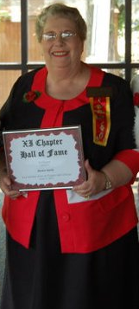
Sandra Smith, Xi 2009-2011
“Hello Sweet Pea,” or “Hello Sugar Pie.” If you hear this you know Sandy Smith is in the room. She greets everyone with her cheery voice and smile and makes everyone feel welcome. During Sandy’s biennium as President her theme was “Bloom Where You Are Planted.” And that we did. Sandy visited and communicated with each chapter often and encouraged members to become involved in DKG beyond the chapter level. She also encouraged the alignment of Alpha Gamma state bylaws and standing rules with the newly adopted International documents. This took a great deal of study and consideration by both the rules committee and the members at large.
During Sandy’s presidency much work was done on planning the 2011 SER in Louisville. Susan Cross chaired this event. During the planning stages the southeast regional director Elizabeth Garner died very suddenly. This caused Libby Watson to ascend into this director’s position and have to pick up where Elizabeth left off on planning the SER. After much worry, this convention went off “without a hitch” and was one to remember by all who attended.
Sandy was born in Louisville, grew up in Louisville and taught in Louisville. She attended Jefferson County Public schools and graduated from Southern High School. Sandy then began her college career at Kentucky Southern College and graduated from the University of Louisville with a BS in Elementary Education. She completed her Master’s degree from Indiana University Southeast and completed further studies in counseling through Western Kentucky University. Sandy taught grades K-5 beginning in the Louisville Public Schools which later merged with the Jefferson County School System. Sandy was fortunate enough to study the British and Chinese education system by attending courses in China!
Sandy is the oldest of 4 children and is a devoted daughter to her parents who still live in Louisville. She also is a beloved Aunt to eight nieces and nephews and 13 great nieces and nephews.

Slide 18
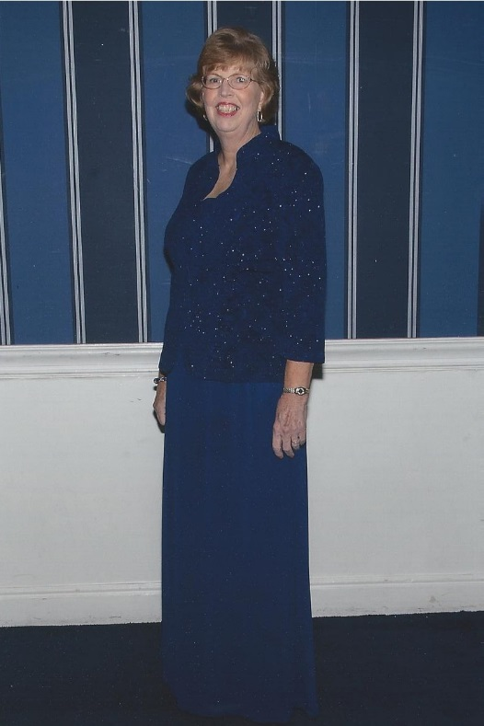
Jane Thompson, Beta 2011-13
Born in Owensboro but starting her school years in Ohio, Jane quickly learned what teaching was about. She recalls a teacher tying her left hand to her desk to try to “train” her to use her right and ripping her dress getting out for a fire drill! After that beginning her family moved back to Owensboro for the remainder of her elementary schooling and then to Louisville for her high school years. She graduated from Loretto High School but did not have the money to go to college so she began working at Sears. That is where she met her husband. After 13 years of marriage and two children she took the ACT and started college with kids who were born the year she graduated from high school. She graduated from Kentucky State University and continued to receive her master’s degree at Georgetown College. She also worked and has achieved National Board Certification. For the past 24 years Jane has been a fourth grade teacher,
During her biennium as President of Alpha Gamma State – Jane has followed her theme “We Are What They Were Then.” The first “Annie Award” was given to Upsilon Chapter for their “chalk, walk, talk” program. Jane increased leadership opportunities at the state level by separating the corresponding secretary and state webmaster positions. She has promoted greater use of the AG State website for information sharing and/or reducing costs associated with printing and mailings. Jane also instituted the “Order of the Tulip Poplar” composed of all past State Presidents to be an additional resource for the current President, expansion committee and leadership development committee. Jane was the newly elected President when the 201 SER was held in Louisville and had also served on the committee with its planning.
Jane states that Delta Kappa Gamma has allowed her to use her love of reading, her creativity, her “out of the box” thinking and her Pollyanna frame of mind in order to explore many places.

Slide 19
Karen Martin, Upsilon, 2013-2015

